Slide 3
SQL Agent in the Cloud Elastic Database Jobs
Sam Cogan

Slide 4




Sam Cogan
Solution Architect – Willis Towers Watson
Microsoft Azure MVP
samcogan.com
@samcogan
sam-cogan

Slide 5





SQL Agent Alternatives
SQL Agent is not present in Azure SQL
SQL IaaS
Azure Automation
Azure SQL Elastics Jobs
Azure SQL
Managed Instance
Azure Functions

Slide 6






Elastic Database Jobs
Write Jobs in T-SQL
Run jobs across databases in parallel
Supports Azure SQL Databases, Servers and Elastic Pools
One-Off or scheduled jobs
Currently in preview
$10-$3000 per month – Depends on job database size

Slide 7

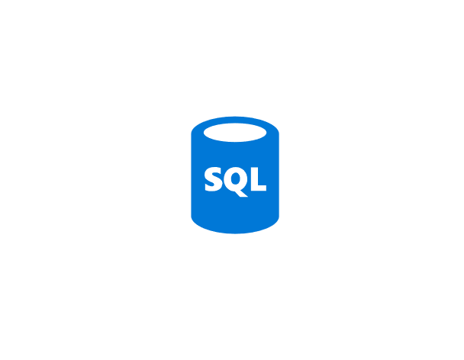
SQL Elastic Jobs
Azure SQL Server
Azure SQL Server
Job Agent
Execute job on targets
Read Job definition
Write Job Status
Job Database
Azure SQL Server
Azure SQL Server
Write Job Output
Elastic Pool
Output Database

Slide 8
Sam Cogan
Solution Architect – Willis Towers Watson
Microsoft Azure MVP
samcogan.com
@samcogan
sam-cogan

